Slide 1
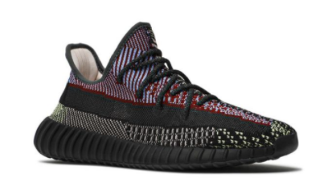
Duc, who has just bought his new pair of yezzy sneakers, decides to ……….. the mountain.
He brings with him food and water ……….., and follows the ……….. which lead him from the ……….., through the ……….. , and finally to the ……….. of the mountain where he can find a ……….. to stay overnight.
Along the way, he leaves many ……….. of his footsteps on the ground. The ……….. is really long, so he needs to ……….. his energy.
In conclusion, Duc loves his sneakers.
ascend
supplies
Marked trails
Steep
slope
foot
summit
Hut/shelter
traces
conserve
ascent
Notes:
Students benefit considerably from revising lessons at home.

